Slide 1
Stephanie
Virtual Assistant At Your Service

Slide 2

Little About Me
I am Ujjwal Gupta.
Created Stephanie and Sounder along with few other open source libraries.
Currently working as a software engineer.

Slide 3
Introduction

Slide 4
Why Stephanie?
Completely Open Source.
Minimalistic hardware requirements.
100% Customizable.
Developer Friendly.
Framework rather than application.

Slide 5
Outlines of this talk
Installation
Configuration
Usage
System Architecture
Sounder (Intent Recognition Algorithm)
Developer API
Pre-installed Modules

Slide 6
Installation
Requires no more than few clicks.

Slide 7
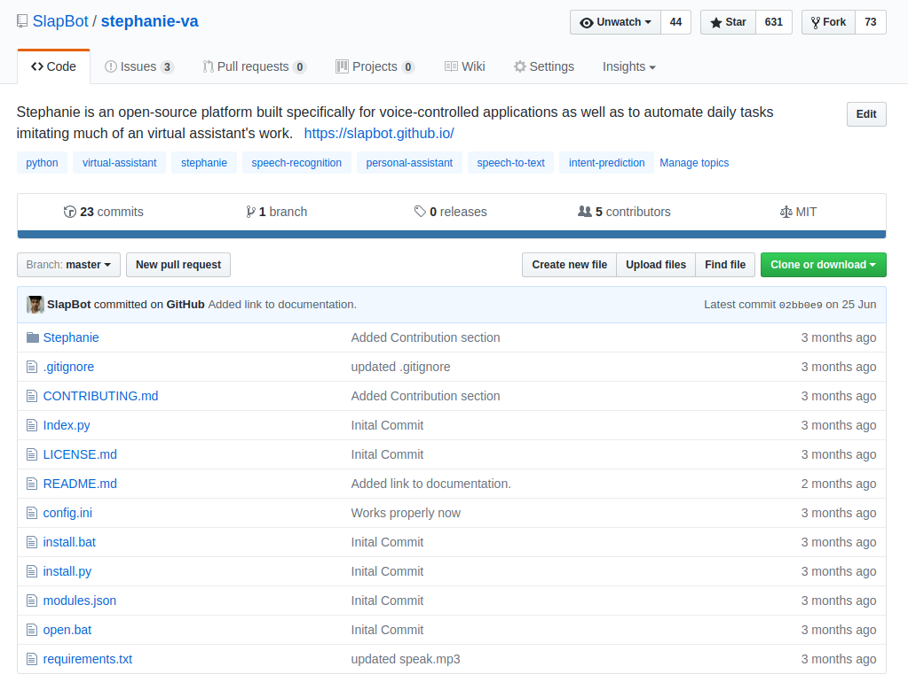
Installation
Go to the Github page.
Clone the repo.
Run install.py
?
Profit.

Slide 8
Configuration
Completely customizable to your needs.

Slide 9
Configuration
Application
Version, update_check
User
Name, age, gender, city, etc.
System
Assistant_name, welcome_message, wake_up_engine, always_on_engine, etc.
Speech To Text
Initial_engine, master_engine
Modules
Facebook, twitter, evernote, gmail, calendar, weather, etc.
Etc.

Slide 10
Usage
Controlled by your voice.

Slide 11
Usage
Different ways to give commands
Run index.py to boot up the application.
Hey Stephanie, Do a status update on facebook.
Stephanie, What’s trending on twitter?
Can you note something for me?
Yo Stephanie, do I have any calendar events pending for today?

Slide 12
System Architecture
General overview of the internal API

Slide 13
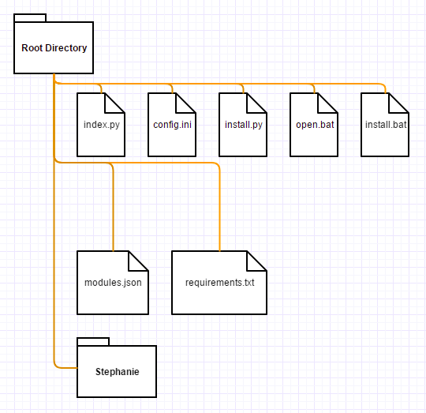
Root Directory Structure
index.py - Entry point to boot up the application.
config.ini - Manages configuration settings
install.py - Installer to install dependencies
open.bat - wrapper to call index.py
install.bat - wrapper to call install.py
requirements.txt - Required dependencies
modules.json - Modules Information
Stephanie - Actual package which controls everything.

Slide 14
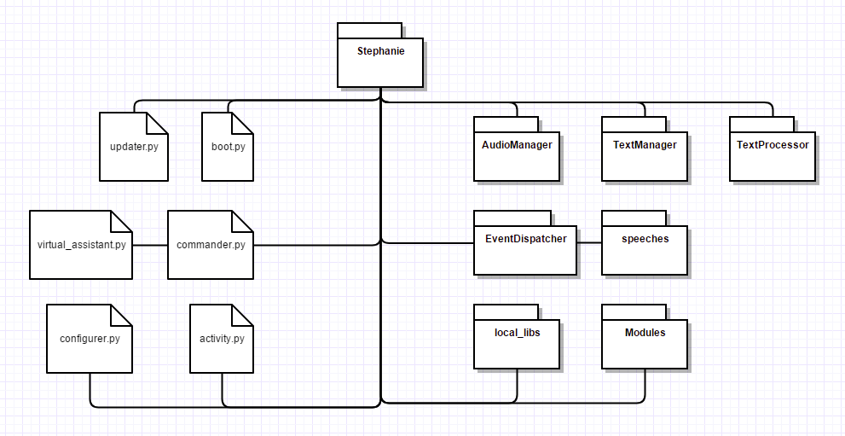
Stephanie Directory Structure

Slide 15
Sounder
Language parsing algorithm to predict the intent

Slide 16
Sounder
Sounder is an intent-recognizing algorithm which uses five main principles:
Stopwords filtering
Phonetic Algorithm (Metaphone)
String metric (Levenstein Edit Distance)
Maximum weight matching (Munkres Algorithm)
Average likelihood (Mean + High Sum Value)

Slide 17
Stopwords filtering
Stop Words are words which do not contain important significance.
They return vast amount of unnecessary information.
This technique is used quite often in NLP algorithms to filter out meaningful keywords from a given sentence
For example: a, an, the, has, have, had, etc.

Slide 18
Phonetic Algorithm (Metaphone)
Metaphone is used to return an approximate phonetic value.
It is used to break a complex word into a simple one.
It simplifies a word to a level of fuzziness to allow smart comparisons.
it creates the same key for similar sounding words
For an example: “Stephanie” and “Stephany” both becomes “STFN”, whereas “Teffany” becomes “TFN”.

Slide 19
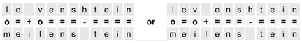
String Metric (Levenstein Edit Distance)
Used for measuring the difference between two sequences (often strings)
calculates the least number of edit operations required to change one string to the other
Edit operation can be any of insertion, deletion and substitution.
"=" Match "o" Substitution "+" Insertion "-" Deletion
It basically returns a value between 0.0 to 1.0 where 1.0 means exact match.

Slide 20
Maximum Weight Matching (Munkres Algorithm)
Also known as Hungarian Algorithm solves the assignment problem
Combinatorial optimization algorithm to compute maximum output
Name | Maths | Physics | Chemistry
Karan | 75 | 55 | 89
Aarush | 69 | 42 | 80
Renu | 80 | 73 | 85
Allotting subjects such that overall marks are the highest can be computed using it: karan => 89, Aarush => 69, Renu => 73. Total => 231

Slide 21
Average Likelihood (Mean + High Sum Value)
Computing the mean of each of the record present in dataset
Choosing the maximum mean value
In case of equal averages, choose the one with higher sum value

Slide 22
Putting It All Together
Sentence is first broken down into keywords by filtering out subwords
It is then converted into metaphone to ensure robustness (if needed)
Each word is searched against dataset to compute edit distance
Above matrix is then used to calculate the maximum cost using munkres algorithm
Each cost is then averaged across the dataset.
Maximum averaged value is chosen as the final result.

Slide 23
Rough Example
>> “What is the date today?”
>> [‘date’, ‘today’]
>> compared against dataset of [[‘date’, ‘today’], [‘twitter’, ‘notifications’], …]
>> received maximum cost of [[1.0, 1.0], [0.2, 0.3], …]
>> compute the averages [1.0, 0.25, …]
>> Pick the highest value.

Slide 24
“Everything should be made as simple as possible but not simpler”
- Albert Einstein

Slide 25
Developer API
Framework rather than an application

Slide 26
Developer API
Built with a clear thought of providing a framework than being an application.
Offers a rich well documented API to extend the functionality
Easy to understand and get started with
Can handle complex business logic
Scales nicely to one’s needs.

Slide 27
Demo (Test Module)
from Stephanie.Modules.base_module import BaseModule class TestModule(BaseModule): def __init__(self, *args): super(TestModule, self).__init__(*args)

Slide 28
def ask_favorite_food(self): self.assistant.say(“What is your favorite food?”) user_command = self.assistant.listen().decipher() response = “Oh really? My favorite food is ” + user_command + “ too!” self.assistant.say(response)
Now simply add the instructions at modules.json file: [ . . [..], [..], ["FacebookModule@GetNotifications",["facebook", "notifications"]], ["ZomatoModule@handle",["feeling", "hungry"]], ["TestModule@AskFavoriteFood",["ask", "favorite", "food"]] ]
["ClassName@FunctionName", ["keywords", "trigger", "module"]]

Slide 29
And that’s it
You successfully created your first dummy module.
Simply restart the Stephanie, and use any of the following commands like:
Hey Stephanie, ask my favorite food.
Do you wanna know my favorite food?
Ask which kind of food is my favorite.

Slide 30
API reference
Properties
raw_text, sub_words, key_words, key_words_assigned, etc.
Assistant Object
say(text), listen(), decipher(), set_modules(sub_dataset), learn(raw_text), understand(), etc.
Events Object
add(event_name), trigger(event_name), etc.
Config Object
get_configuration(key, section=”modules”)
etc.

Slide 31
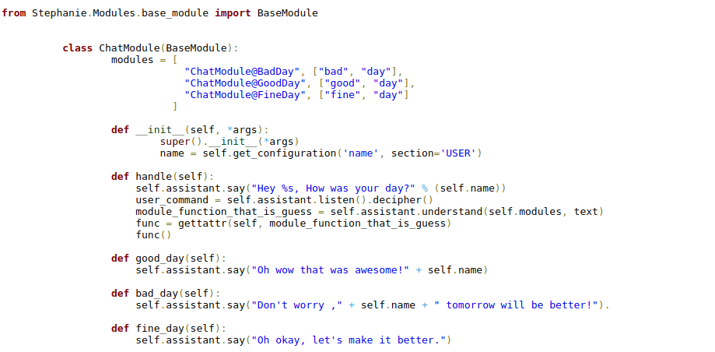
Advanced Usage

Slide 32
Stephanie is a framework designed to create your own virtual assistants

Slide 33
Modules
Builtin modules shipped out of the box

Slide 34
Modules
Questions (Wolfarama Alpha)
News (Newsapi.org)
Weather (Open Weather)
Notes (Evernote)
Emails (Gmail)
Twitter (twitter.com)
Facebook (facebook.com)
Calendar (Google Calendar)

Slide 35
Few more of them...
Football (football-data.org)
Restaurants (Zomato)
Wikipedia (Wikipedia Foundation)
Movies (Omdb)
System (OS related)

Slide 36
600+
Stephanie has received an immense support in the social media such as github, hackernews, reddit, etc.

Slide 37

Questions?

Slide 38

Thanks!
Contact me:
Ujjwal Gupta
Website: slapbot.github.io
Github: github.com/slapbot
Email: ugupta41@gmail.com

